Slide 1
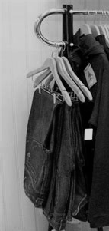

Hackathon Subject : Your Next Purchase Recommending the right product to each client for a marketing action
February 10th – 15th, 2025
Zongru SUN, Binong HAN, Jinsuh YOU, Julien DEHUT, Solène LEBOUCHER, Tonghan WEN

Slide 2



A need to automate product recommendations​
Our client, a player of the retail industry, would like to improve the performances of marketing actions
For now, they only have a manual product recommendation system generalized to all clients
They want to implement a recommender system based on AI, personalized to each client
What products is each client most likely to buy?
How can we leverage these insights for strategic recommendations?

Slide 3


An AI-based process which allows immediate product recommendation
Prospect comes to a shop or creates an account
Prospect becomes a client
First purchase anniversary
Client is at risk of churning
Prospect becomes a client
Automatic AI-based product recommendation
Client makes new purchases
Current manual process
Low customization (one-to-many)
Lack of visibility on performance
AI-powered process
Immediate and automatic generation of product recommendation
Consideration of the available stock
Continuous metrics improvement
Test and learn approach made possible

Slide 4



Objectives (Business-View)
Revenue increase
Design an automatic personalized recommendation system to max long-run profit
Revenue (Increase)
Cost(Decrease)
Cost reduction
# of client
# of transaction
Revenue / transaction
Cost of stock
Cost of stock
Cost of stock
Increase in Loyal Proportion
Increase in transactions
Consider gross profit when recomending products
Optimize recommendation considering stock info
Optimize recommendation considering store place
Notes:
Key benefits:
Push the right product recommendation to the right client thus increasing number of repeaters
Increase % of loyal customers (repeat purchases in 6 months)
Improve conversion rate from prospects to customers
Reduce churn by re-engaging inactive users
Optimize recommendation efficiency & reduce manual effort
Increase average basket size per customer

Slide 5
Objectives (Technical-View)
Design an automatic personalized recommendation system
Revenue (Increase)
Cost(Decrease)
Cost reduction
# of client
# of transaction
Profit / transaction
Revenue / transaction
Cost of stock
Cost of transportation
User profile construction
Product similarity calculation
Complementary product recommendation
Diversed & Novel recommendation
Product stock tracking
Store & Client location tracking
Metrics:
2 Models:
Model 1: Based on User profile construction & product similarity & stock location
Model 2 : xxxxx & stock location
Notes:
Key benefits:
Push the right product recommendation to the right client thus increasing number of repeaters
Increase % of loyal customers (repeat purchases in 6 months)
Improve conversion rate from prospects to customers
Reduce churn by re-engaging inactive users
Optimize recommendation efficiency & reduce manual effort
Increase average basket size per customer

Slide 6
Key Success Factors
WHY?
HOW?
Enhance 'Loyal' customer experience
Majority of clients are loyal
Generating most revenue
Recommend most similar products with one more totally new different product
More transactions = more loyal
Reduce Churn Rate & Improve Retention
Inactive - > loyal
Loyal clients base - > more transactions & more revenue
Recommend based on previous transactions & similar customers
Increase Conversion Rate
Attract potential customers who browse but don’t buy
Use real-time recommendations (e.g., "X people bought this today") to encourage purchases
Increase Cross-selling
& Upselling
Maximize revenue and profit by recommending several products & higher-value products
Market Basket analysis: find commonly purchased products, promotions & discounts
Rank products by profit margin
Enhanced Operational Efficiency
Reduced stock cost and transportation cost
Optimize stock inventory, transportation between countries

Slide 7
An approach in 3 phases, consisting in exploring, testing and implementing
OBJECTIVES
PHASE 1:
Collect and explore
PHASE 2:
Test and assess feasibility
PHASE 3:
Implement and industrialize
ELEMENTS OF METHODOLOGY
Collect internal data sources
Get external data to complete them (product descriptions, market trends)
Create a baseline model
Test of the model: A/B test against baseline recommendations
Create different models and compare their performances
Implement CI/CD pipeline and API endpoints
Set up cloud-based or on-premise infrastructure
Collaborate with business and marketing teams to understand the objectives and expectations for the recommendation system + analysis of the existing
Gather insights on KPIs
Choose the most performant model and improve it on an iterative way
Integrate frontend
Implement KPIs for tracking recommendation effectiveness
Perform exploratory analysis (EDA) of the data
Evaluate the performances of the models using recall as metric
Conduct user acceptance testing
Automate retraining based on user feedback
PRACTICAL IMPLEMENTATION
Data collection
Stakeholder interviews
Data cleaning and EDA
Initial Data Insights
Develop and train models (collaborative filtering, ALS, deep learning models)
Compare performances using evaluation metrics
Optimize and validate
Deploy a cloud-based API
Set up monitoring and logging
Automate CI/CD deployment
DELIVERABLES
Data inventory report
Stakeholder insights report
Data summary presentation
Baseline model and model comparison reports
Performance Analysis
Evaluation report
Deployed recommendation API
Monitoring Dashboard
Notes:
1️⃣ Deploy a Cloud-based API – Host the recommendation model using a cloud service (e.g., AWS Lambda, GCP Cloud Run, or Azure Functions) and expose it via REST or GraphQL.
2️⃣ Set Up Monitoring & Logging – Use tools like Prometheus, Grafana, or ELK Stack to track API usage, model drift, and system performance in real-time.
3️⃣ Automate CI/CD Deployment – Implement a CI/CD pipeline (e.g., GitHub Actions, GitLab CI, or Jenkins) to automate testing, versioning, and rolling out updates seamlessly.

Slide 8



A mission over 3 months
Collect and explore
Collect, clean and explore data
Exchange with stakeholders
Test and assess feasibility
Create some models and compare them
Improve them on an iterative way
Implement and industrialize
Test
Implement pipeline
Deploy frontend and get user-feedback
Kick-off
Weekly meeting
Weekly meeting
Test of a 1st model
Weekly meeting
Weekly meeting
Weekly meeting
Final model chosen
Weekly meeting
Weekly meeting
Weekly meeting
Model deployed and industrialized

Slide 9
Transforming Raw Data into Actionable Insights
Data preparation
Model training
Evaluation
Dataset Overview
Pre-processing steps
1.12 million transactions
Customer:
Loyal customers: 66%
Prospect:18%
Inactive_1y: 15%
Top: 0.5%
Number of products in each transaction:
Mean: 1.93
50%: 2.00
Top 3 purchased categories (Quantity):
Football 583k
Tennis 312k
Rugby 198k
Stock quantity:
Mean:6.99
50%: 3.00
Remove columns Age (70% missing data) & Gender ('C','N','U)
Merge datasets: 'transaction' & ClientID & ProductID (left join)
Merge datasets: stocks & products
Create 'CategoryFamily' that combine 'Category' and 'FamilyLevel1' (e.g., 'Cycling-Helmet')
Customer segmentation (Loyal & Top together, Inactive alone)
Train-Validation split
1. Group transactions by ClientID
2. Split each client's purchase history:
- 70% training (past purchases)
- 30% validation (recent purchases)

Slide 10
Collaborative Filtering and LSTM models to recommend products
Data preparation
Model training
Evaluation
Collaborative Filtering (CF)
& Content-based filtering (CBF)
LSTM
Embedding of the category + families of the products
Collaborative filtering to suggest 3 products that has weighted similarity to their purchased products
Look at which products are bought together (market basket analysis) and recommend 3 products based on the category
Recommend 1 product totally different from the ones bought by the customer, to detect if the customer has potential interest on unseen product
Total 7 products = 3 similar products + 3 paired products + 1 product
Recognize patterns by grouping customer's past purchases as sequence, in chronological order
Encoding categories for model training
Process sequences to LSTM (Long-Short Term Memory) network and learn recurring shopping patterns
Train the model with CrossEntropyLoss & Adam optimizer
Output the top 3 most likely product categories for each user

Slide 11
Assessing Performance: Recall as the chosen metric
Data preparation
Model training
Evaluation
✅ Model Performance
fff
Recall@3: 73% for 20 clients, 49% for LSTM
Loss: 2.6 (value after model convergence)
✅ Key Insights
Recommended products match customers' purchasing trends well.
Positive impact on inventory optimization and cross-selling.
fff

Slide 12
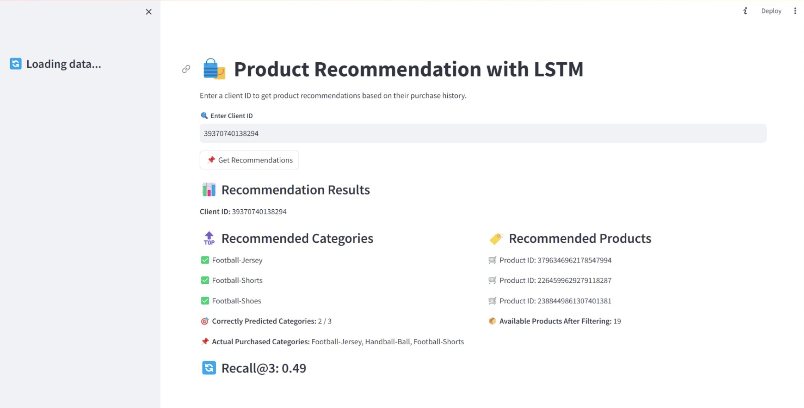
Interactive Data Exploration: Visualizing with Streamlit

Slide 13



Some challenges due to the size of the dataset and the choice of the evaluation method
DATA
COMPUTATIONAL CHALLENGES
EVALUATION
No rating on the purchase made by the customers and no information about the products
Few information about product characteristics (just name, category and family level)
Try of graph models but crashed each time
Try of applying Sentence transformer, then clustering models on the products and customers, but the models crashed. This is mainly due to the large size of the dataset
Choice and computation of the metrics: given the large number of products, slight variations in recommendation should not be considered as errors
Choice of the method to split the data between training and testing sets (based on timeline / clients or just randomly)

Slide 14



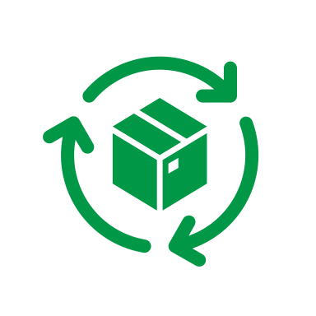




Next steps
MODEL IMPROVEMENTS
STRATEGY BASED ON RECOMMENDATION SYSTEM
STRATEGY FOR DIFFERENT CUSTOMER SEGMENTATIONS
PROSPECT
Make our collaborative filtering model scalable (now only 20 clients)
Personalized email campaigns with tailored recommendations to present new products / regular personalized newsletters
Collect data about the prospects if possible
Online behaviour
Survey to know more their preferences
If no information
Recommend the most popular items
Effort on advertisement
Try to capture more semantics about the products, using NLP (like Sentence Transformer/Bert, ensuring that the models are deployable) and do some clusters of products
Cross-selling: offer discounts if two products bought together (for products which are not well sold)
INACTIVE-USER
Send some personalized emails to reignite interest
Personalized win-back discounts
Events to promote the products and test them – invite users which would be interested by those products . E.g., sport merchandise for upcoming tournaments
Search for more efficient model to optimize computation and reduce memory usage
LOYAL USER
Early access to new product drops or exclusive collections
Crawl the web to gather characteristics about the products
TOP USER
Dynamic Pricing & Promotional Offers
Curate personalized shopping experiences with premium selections
Prospects:
Collect data about them
Look at their behaviour on websites (number of clicks...) -> make recos respectively, as if purchase
Survey?
How to use the recommendation system
Personalized email campaigns
Events? (presentations of some products?)
Discounts?
Maybe 1 product randomly selected and not based on the preferences

Slide 15
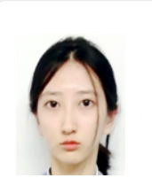
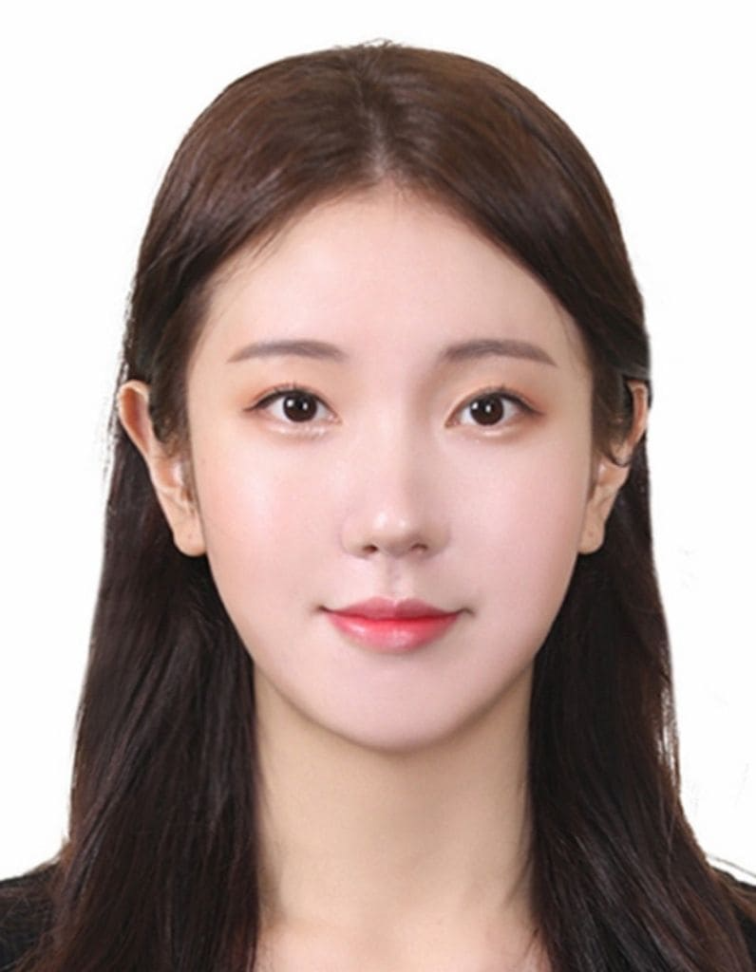




Team
Jinsuh YOU
MS DSBA CentraleSupélec & ESSEC
Background : Biomedical engineering
Binong HAN
MS DSBA CentraleSupélec & ESSEC
Background : Business
Julien DEHUT
MS DSBA CentraleSupélec & ESSEC
Background : Industrial engineering
Tonghan WEN
MS DSBA CentraleSupélec & ESSEC
Background : Business
Solène LEBOUCHER
MS DSBA - CentraleSupélec & ESSEC
Background: Business
Zongru SUN
MS DSBA CentraleSupélec & ESSEC
Background : Finance

